Slide 1
Table of Contents
Intro
Dijkstra algorithm
Pathfinding in general
Setting up the project
Tiles and grid
The algorithm / pseudo
The path
Improvements

Slide 2
Dijkstra
c
b
1
5
12
2
a
8
f
10
3
d
10
e

Slide 3
Dijkstra
c
b
1
5
12
2
a
8
f
10
3
d
10
e

Slide 4
Dijkstra
c
b
1
5
12
2
a
8
f
10
3
d
10
e

Slide 5
Dijkstra
c
b
1
5
12
2
a
8
f
10
3
d
10
e

Slide 6
Dijkstra
c
b
1
5
12
2
a
8
f
10
3
d
10
e

Slide 7
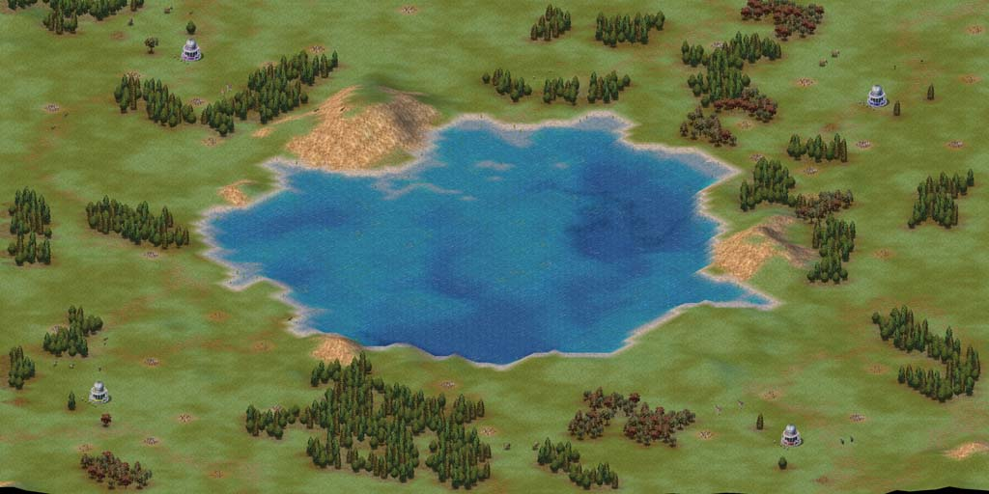

Slide 9
Representation of the world
(0,0) | (0,1) | (0,2) | (0,3) | (0,4) | (0,5) | (0,6)
(1,0) | (1,1) | (1,2) | (1,3) | (1,4) | (1,5) | (1,6)
(2,0) | (2,1) | (2,2) | (2,3) | (2,4) | (2,5) | (2,6)
(3,0) | (3,1) | (3,2) | (3,3) | (3,4) | (3,5) | (3,6)
(4,0) | (4,1) | (4,2) | (4,3) | (4,4) | (4,5) | (4,6)

Slide 10
World = nodes
(0,0) | (0,1) | (0,2) | (0,3) | (0,4) | (0,5) | (0,6)
(1,0) | (1,1) | (1,2) | (1,3) | (1,4) | (1,5) | (1,6)
(2,0) | (2,1) | (2,2) | (2,3) | (2,4) | (2,5) | (2,6)
(3,0) | (3,1) | (3,2) | (3,3) | (3,4) | (3,5) | (3,6)
(4,0) | (4,1) | (4,2) | (4,3) | (4,4) | (4,5) | (4,6)

Slide 11
Defining de world
0 1 2 3 4 5 6
0
1
2
3
4
(0,0)
(1,0) | (1,1) | (1,2) | (1,3)
(2,0) | A (2,1) | (2,2) | (2,3) |  | B (2,5)
(3,0) | (3,1) | (3,2) | (3,3)
Notes:
Non walkables = {(1,3), (2,3), (3,3)}

Slide 12

Manhattan distance
0 1 2 3 4 5 6
0
1
2
3
4
F G H
74 14 60 | 60 10 50 | 54 14 40
60 10 50 | A | 40 10 30 | ... | ... | ... B
74 14 60 | 60 10 50 | 54 14 40 | ... | ... | ...
Notes:
F = G + H
G – cost from the moving starting point
H = estimated movement cost to move from that given square to the final destination (B)
Choose from the OpenList = {(1,0), (1,1), (1,2), (2,0), (2,2), (3,0), (3,1), (3,2)} the node with the lowest cost (=F).

Slide 13
Determine the next step
0 1 2 3 4 5 6
0
1
2
3
4
F G H
74 14 60 | 60 10 50 | 54 14 40
60 10 50 | A | 40 10 30 | ... | ... | ... B
74 14 60 | 60 10 50 | 54 14 40 | ... | ... | ...
Notes:
Lowest F costs is the square right to square A (starting square). This is square (2,2) from the OpenList.Drop this square from the OpenList and add it to the ClosedList.
So we have the following situation:
OpenList = <(1,0), (1,1), (1,2), (2,0), (3,0), (3,1), (3,2)> // remove (2,2)
ParentIs(2,1) = <(2,1), (1,0), (1,1), (1,2), (2,0),(2,2), (3,0), (3,1), (3,2)>
ClosedList = <(2,1), (2,2)>
OpenList =<(1,0), (1,1), (1,2), (2,0), (3,0), (3,1), (3,2)> //nothing added because all
wakable neighbours of (2,2) already in list

Slide 14
If same choose the last from list
0 1 2 3 4 5 6
F
G H
0
1
2
3
4
 |  |  |  |  |  | F G H
74 14 60 | 60 10 50 | 54 14 40
60 10 50 | A | 40 10 30 |  |  | B
74 14 60 | 60 10 50 | 54 14 40
 | 88 28 60 | 74 24 50
Notes:
OpenList = <(1,0), (1,1), (1,2), (2,0), (3,0), (3,1), (3,2)>
ParentIs(2,1) = <(2,1), (1,0), (1,1), (1,2), (2,0),(2,2), (3,0), (3,1), (3,2)>
ClosedList = <(2,1), (2,2)>
Continue
OpenList = <(1,0), (1,1), (1,2), (2,0), (3,0), (3,1), (3,2)> // remove (3,2), add (4,1), (4,2).
ParentIs(3,2)=<(4,1),(4,2)>
OpenList = <(1,0), (1,1), (1,2), (2,0), (3,0), (3,1), (4,1), (4,2)>

Slide 15
Diagonal is closer
0 1 2 3 4 5 6
0
1
2
3
4
94 24 70 | 80 20 60 | 74 24 50
74 60 14 | 60 10 50 | 54 14 40
60 10 50 | A | 40 10 30 |  | 82 72 10 | 68 68 0 | 82 72 10
74 60 14 | 60 10 50 | 54 14 40 |  | 74 54 20 | 68 58 10 | 88 68 20
94 24 70 | 80 20 60 | 74 24 50 | 74 34 40 | 74 44 30 | 74 54 20 | 102 30

Slide 16
Have a closer look at (4,1)
0 1 2 3 4 5 6
0
1
2
3
4
94 24 70 | 80 20 60 | 74 24 50
74 60 14 | 60 10 50 | 54 14 40
60 10 50 | A | 40 10 30 |  | 82 72 10 | 68 68 0 | 82 72 10
74 60 14 | 60 10 50 | 54 14 40 |  | 74 54 20 | 68 58 10 | 88 68 20
94 24 70 | 80 20 60 | 74 24 50 | 74 34 40 | 74 44 30 | 74 54 20 | 102 30
Notes:
The costs are 14 + 14 = 28 because you would take 2 times a diagonal step if your path would be (1,2)<- (2,3) <-(4,1)

Slide 17
The cost & parent changes
0 1 2 3 4 5 6
0
1
2
3
4
94 24 70 | 80 20 60 | 74 24 50
74 60 14 | 60 10 50 | 54 14 40
60 10 50 | A | 40 10 30 |  | 82 72 10 | 68 68 0 | 82 72 10
74 60 14 | 60 10 50 | 54 14 40 |  | 74 54 20 | 68 58 10 | 88 68 20
94 24 70 | 88 28 60 | 74 24 50 | 74 34 40 | 74 44 30 | 74 54 20 | 102 30
Notes:
The costs are 14 + 14 = 28 because you would take 2 times a diagonal step if your path would be (1,2)<- (2,3) <-(4,1)

Slide 18
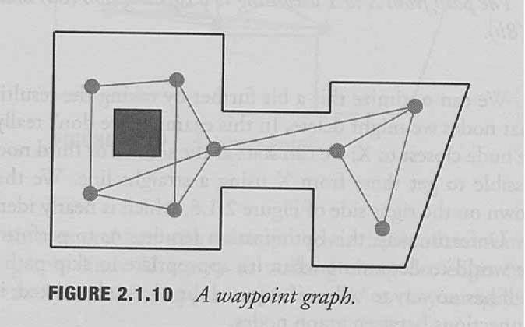
A* implementation issues
Processor attack
Zig zag
Terrain cost

